Slide 1
WordPress Plugin Development
- Abhishek Deshpande
Nagpur PHP Meetup – Jan 2010

Slide 2
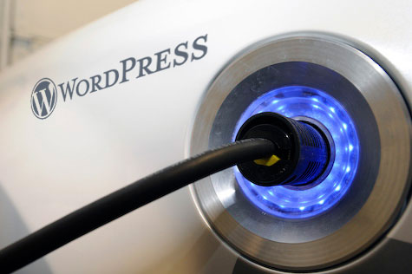
Plugin
To Extend the usability of WordPress Blogging Platform

Slide 3
Why Make WordPress Plugin?
Develop some Functionality
Change the Implementation of Existing Functionality
To Extend existing Functionality
To Simplify the WordPress usability to clients
You want to “EARN”

Slide 4
Lets Take a Look a Few Plugins around us !

Slide 5
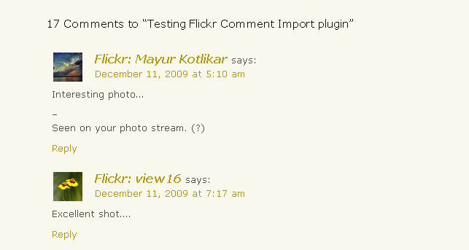
Live Flickr Comment Importer
- Dr. Tarique Sani

Slide 6
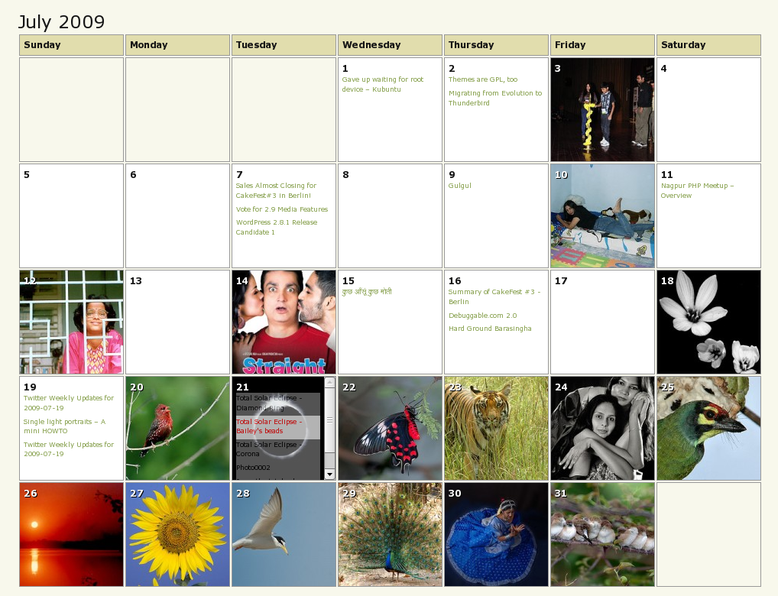
Calendar Archives
- Amit Badkas

Slide 7
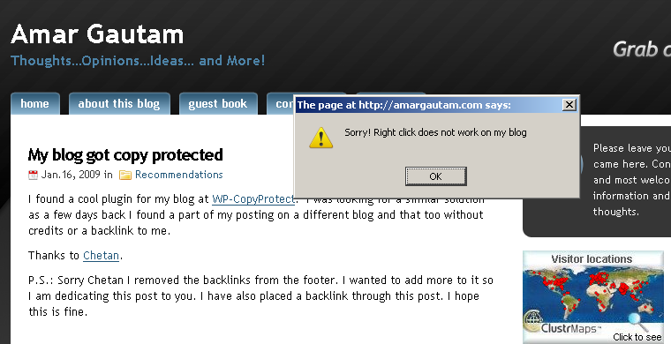
WP-CopyProtect
- Chetan Gole

Slide 8
Writing a Plugin
A Plan
My Functionality to be implemented ( your main function)
What place your function will act?

Slide 9
Writing a Plugin
For each plugin create a folder in /wp-content/plugins/Pluginname
Create the main plug-in file with the same name as the folder. Pluginname.php
Main Elements
Header (Name, version, etc)
Main function
Register functions

Slide 10
Hello Dolly
Not just a plugin, it symbolizes the hope and enthusiasm of an entire generation summed up in two words sung most famously by Louis Armstrong: Hello, Dolly.
Best Plugin to learn WordPress Plugin Code.

Slide 11
Hooks
Actions
Filters
WordPress launches Action Hooks at specific points during execution, or special for a specific event occur.
ACTION API
WordPress launches to alter any text of various types in WP before adding it to the database or sending it to the browser screen.
FILTER API

Slide 12
Resources
http://codex.wordpress.org/
http://adambrown.info/

Slide 13
Thank You.
WordPress Plugin Development
at Nagpur PHP Meetup – Jan 2010
Abhishek Deshpande
http://www.whoisabhi.com
Abhishek@whoisabhi.com
http://twitter.com/deshabhishek007

